Slide 1
Week 7
LXMert, Fast R-CNN & Faster R-CNN

Slide 2
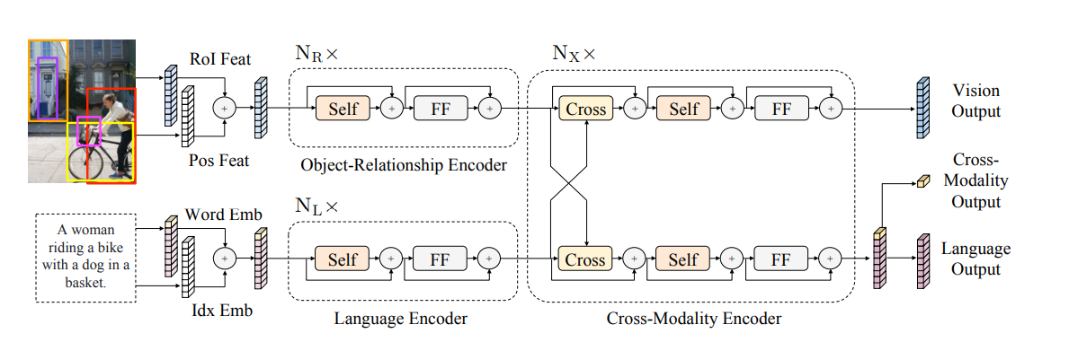
LXMert
Architecture
Embedding

Slide 3
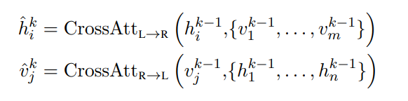
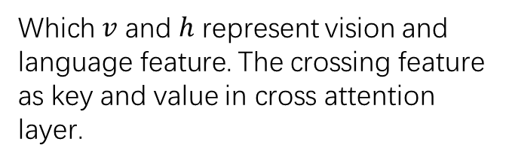
Architecture
Which $v$ and $h$ represent vision and language feature. The crossing feature as key and value in cross attention layer.
From [CLS] token, which add before sentence words.
[CLS] token

Slide 4
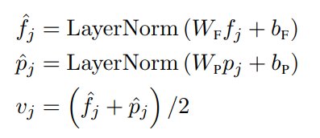
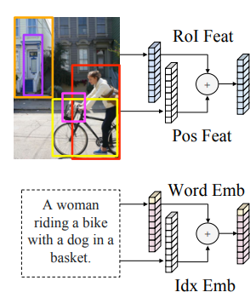
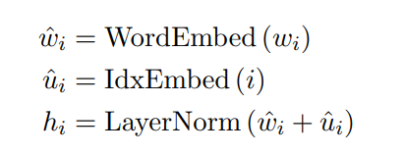
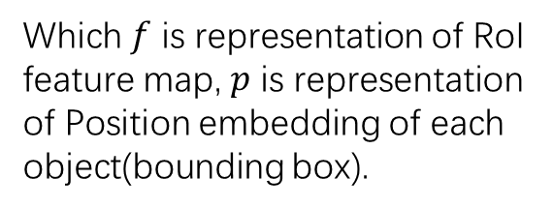
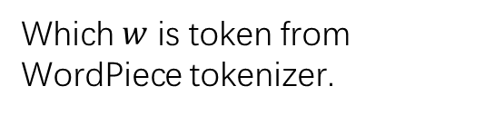
Embedding
Which $f$ is representation of RoI feature map, $p$ is representation of Position embedding of each object(bounding box).
Which $w$ is token from WordPiece tokenizer.

Slide 5
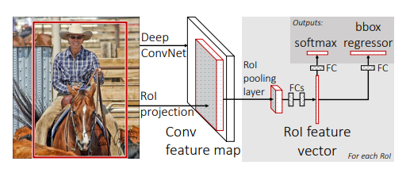
Fast R-CNN
Architecture
RoI pooling layer
Loss function

Slide 6
Architecture
RoI projection
image
ConvNet
Selective Search
Feature map

Slide 7
RoI pooling layer
Max pooling
Same size
RoI feature map
RoI pooling layer

Slide 8



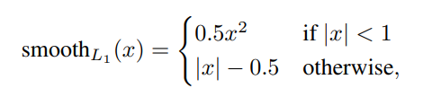
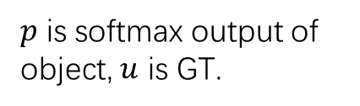
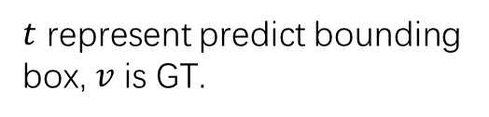
Loss function
$p$ is softmax output of object, $u$ is GT.
$t$ represent predict bounding box, $v$ is GT.

Slide 9
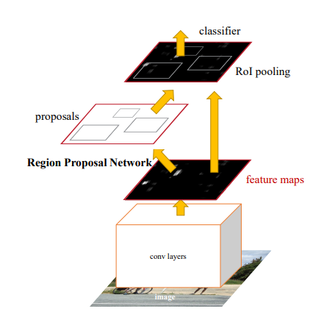
Faster R-CNN
Architecture
RPN
Loss function

Slide 10
Architecture
Proposal RoI from feature map by RPN.

Slide 11
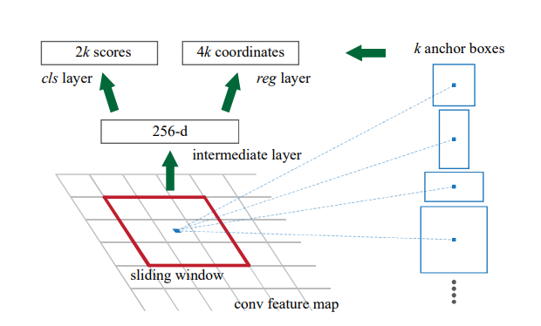
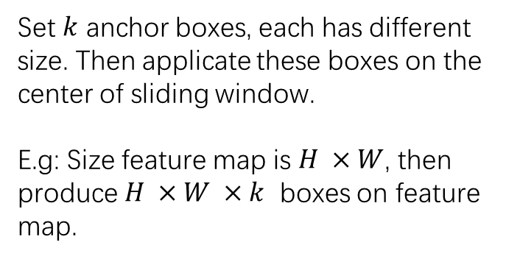
RPN
Set $k$ anchor boxes, each has different size. Then applicate these boxes on the center of sliding window.
E.g: Size feature map is $H ×W$, then produce $H ×W ×k$ boxes on feature map.

Slide 12
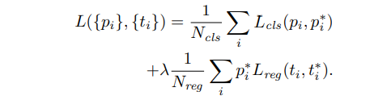

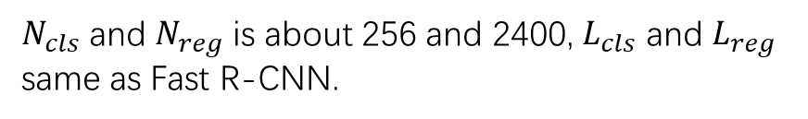
Loss function
$N_{cls}$ and $N_{reg}$ is about 256 and 2400, $L_{cls}$ and $L_{reg}$ same as Fast R-CNN.
If objective cls is true, $p^{∗}=1$, otherwise.
Balance parameter

